Slide 1


UNIVERSITY INSTITUTE OF ENGINEERING
COMPUTER SCIENCE & ENGINEERING
Introduction to Information Security and Cryptography
(Subject Code:20CST-354/ITT-354)
Prepared By : Er. Puneet kaur(E6913)
INTRODUCTION
DISCOVER . LEARN . EMPOWER

Slide 2

El Gamal Digital Signature
www. cuchd.in Campus : Gharaun, Mohali

Slide 3
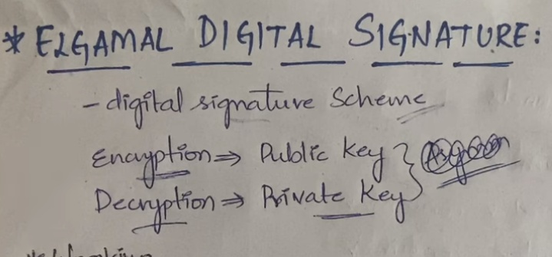

Slide 4
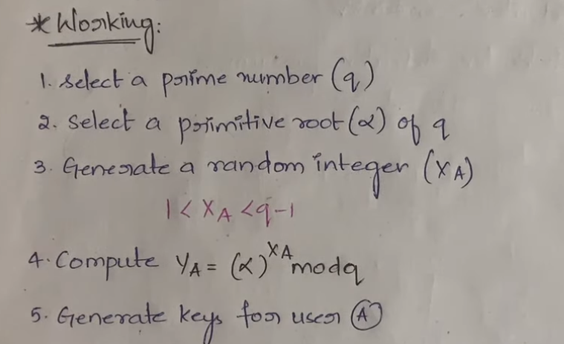

Slide 5
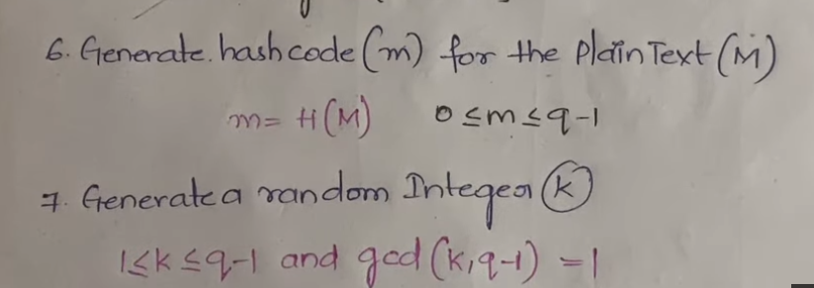

Slide 6
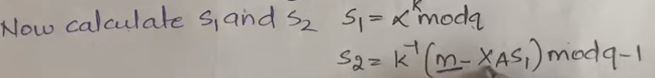

Slide 7
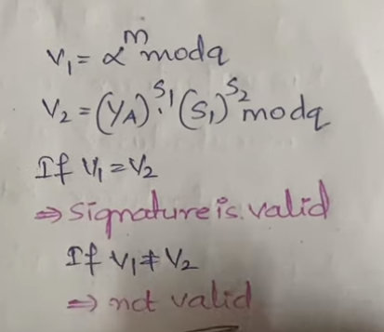

Slide 8
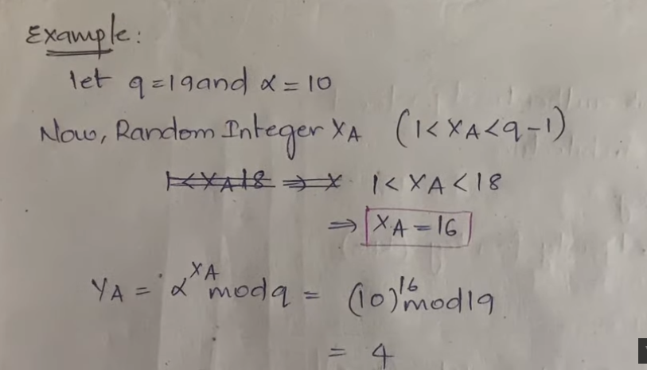

Slide 9
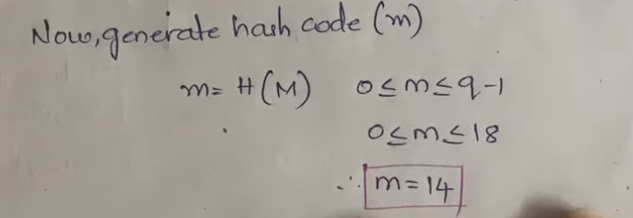

Slide 10
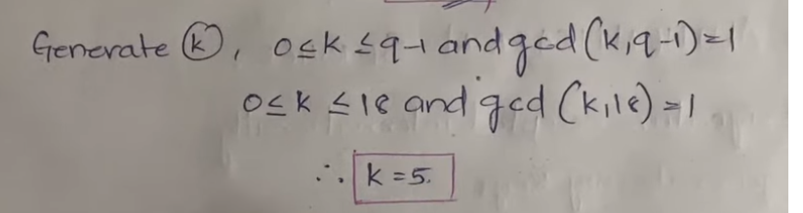

Slide 11
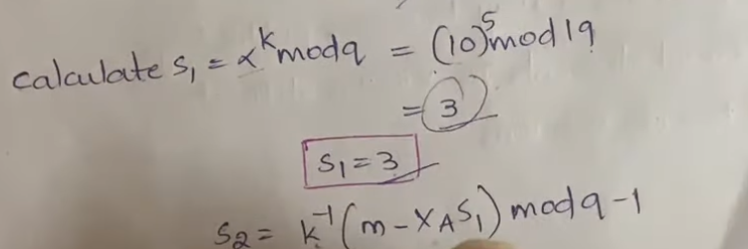

Slide 12
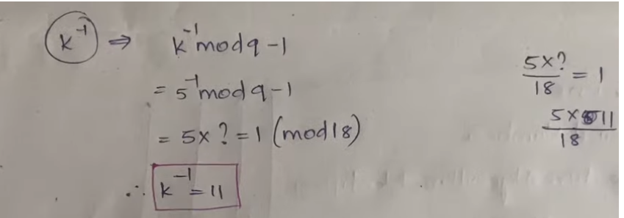

Slide 13
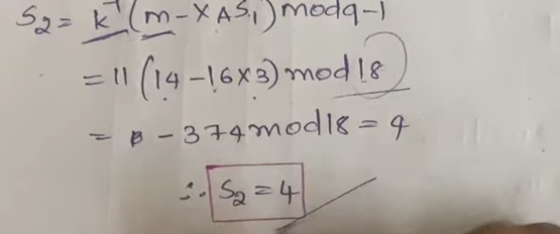


Slide 14
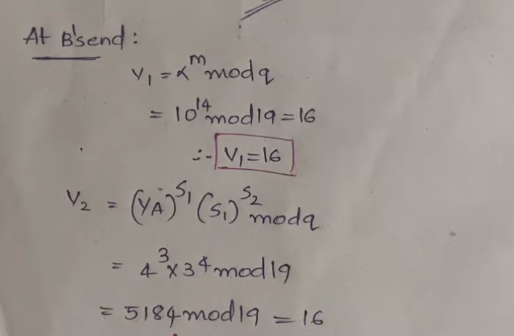

Slide 15
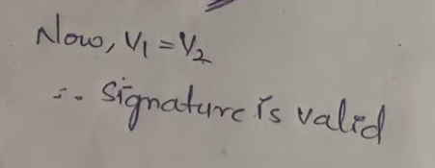

Slide 16
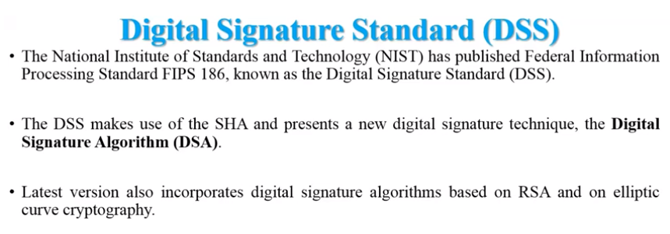

Slide 17
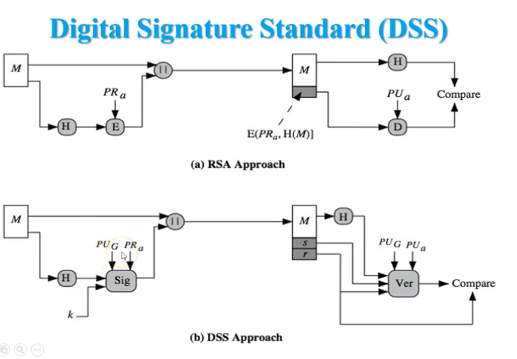

Slide 18
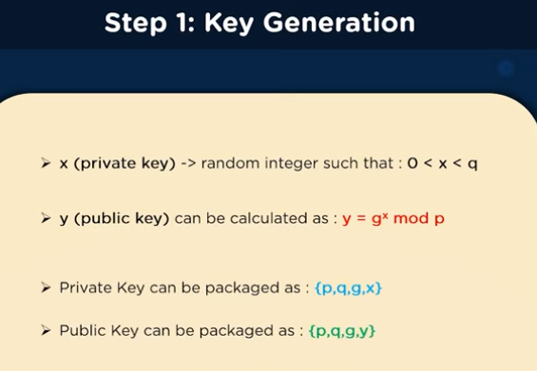

Slide 19
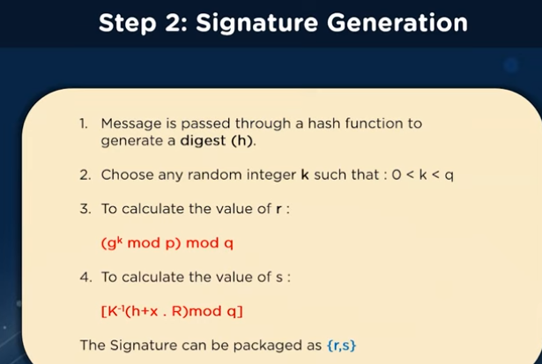

Slide 20
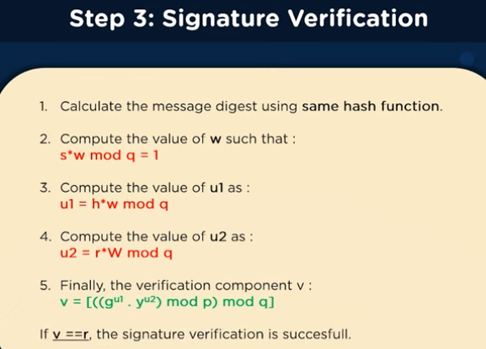

Slide 21
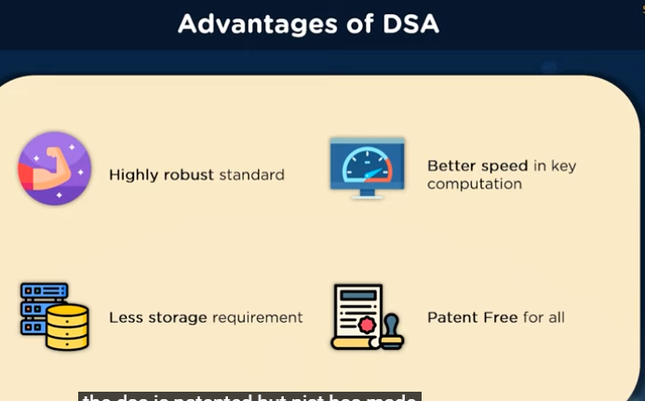

Slide 22
References
http://www.brainkart.com/article/Classical-Encryption-Techniques_8339/
https://www.tutorialspoint.com/cryptography/index.htm
https://www.geeksforgeeks.org/cryptography-introduction/
https://www.techopedia.com/definition/1770/cryptography#:~:text=Cryptography%20involves%20creating%20written%20or,information%20to%20be%20kept%20secret.&text=Information%20security%20uses%20cryptography%20on,transit%20and%20while%20being%20stored.
https://www2.slideshare.net/lineking/classical-encryption-techniques-in-network-security?qid=e388c29f-793d-4f2b-bcaf-9d22e9ca07b5&v=&b=&from_search=1

Slide 23
E- Books Recommended
https://www.pdfdrive.com/cyber-security-books.html
https://bookauthority.org/books/new-cyber-security-ebooks
https://bookauthority.org/books/best-cyber-security-ebooks
https://www.freetechbooks.com/information-security-f52.html

